Slide 1

Hypothesis Testing: Two-Sample Inference

Slide 2
Hypothesis Testing: Two-Sample Inference
Two sample hypothesis-testing problem: means the underlying parameters of two different populations, neither of whose values is assumed known, are compared.
Example: Studying the relationship between oral contraceptive OC ( use birth control/ not use birth control) and average blood pressure in women

Slide 3
Type of study
A longitudinal or follow-up study, the same group of people are followed over time.
Example: Measuring subject’s blood pressure at baseline, year 1, year 2, and year 3 and comparing it by OC use
In a cross-sectional study, the participants are seen at only one point in time.
Example: Measuring a subject’s blood pressure at baseline and comparing it by OC use

Slide 4
Steps for TWO-Sample Test for mean
The four steps in carrying out a significance test:
State the null and alternative hypotheses.
Calculate the test statistic.
Find the P-value.
If the p-value < α : reject the null hypotheses
If the p-value > α :fail to reject the null hypotheses
5.State your conclusion in the context of the specific setting of the test.
Steps are the same but the test statistics is different.
BPS - 5th Ed.
Chapter 14

Slide 5
Teenage Smoking: Stating the null and alternative
In one study, the teenage subjects were given a questionnaire designed to show their level of nicotine dependence. The subjects were divided into “inhalers” (who inhaled while smoking) and “non-inhalers” (who did not inhale). The research is interested in testing whether subject who are non-inhalers have lower levels of nicotine dependence than inhaler?
State the null and alternative hypotheses?
  H₀: μ_{n} = μ_{i}
  H_{a}: μ_{n} < μ_{i}

Slide 6
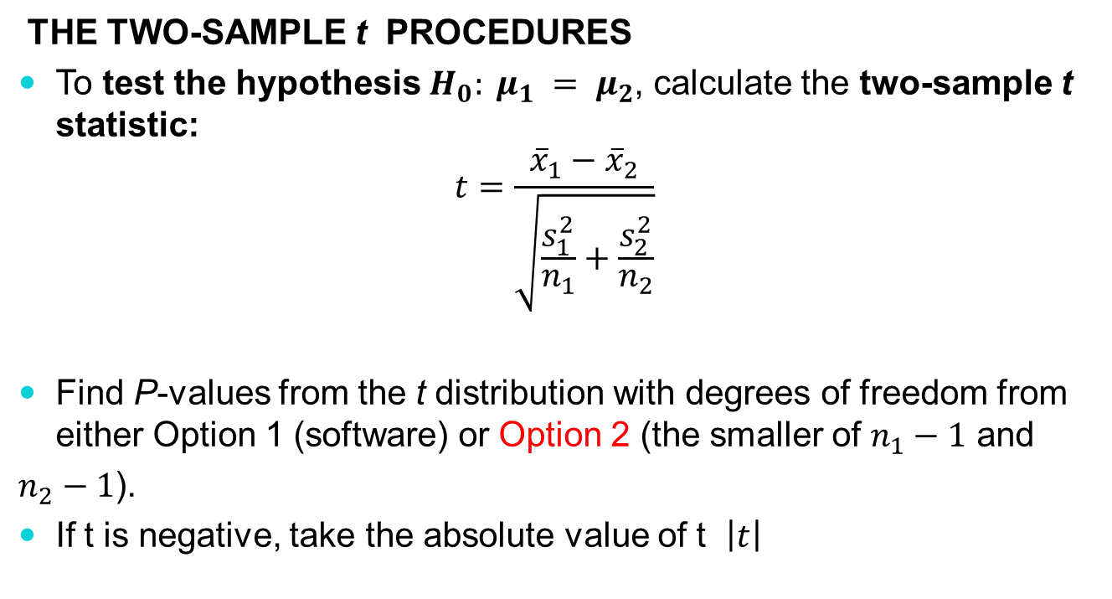
Two-Sample Inference: Test statistics

Slide 7
Example 1: Two-Sample Test for mean
There are 24 students enrolled in an introductory statistics class at a small university. As an in-class exercise the students were asked how many hours of exercise students perform a week. The researcher is interested in testing to see if males exercise more than females. Their responses, broken down by gender, are summarized in the provided table.
Perform hypothesis test?
Group | Sample size | Mean score | SD of score
Male | 13 | 7 | 3
Female | 11 | 5 | 2

Slide 8
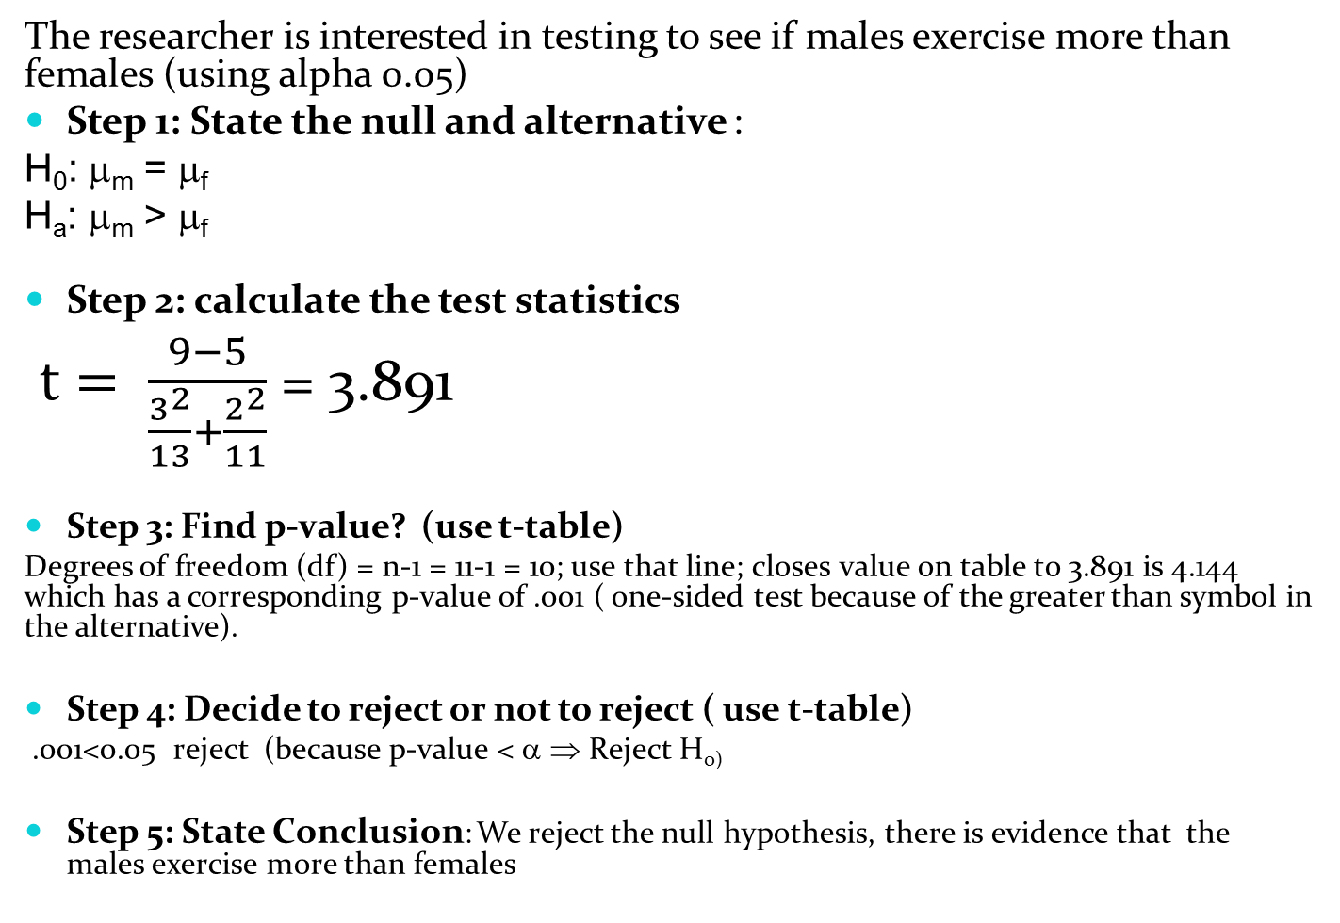
Example 1:Two-Sample Test for mean

Slide 9
STATISTICAL LAB
Comparing the Means of Two Independent Groups

Slide 10
Comparing the Means of Two Independent Groups
Programming a Two-Sample t-test in SAS
proc ttest data= dataset name;
class group variable name; /* defines the grouping variable */
var variable name; /* variable whose means will be compared *

Slide 11
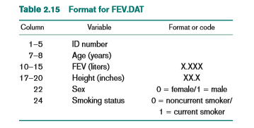
Comparing the Means of Two Independent Groups
Preformed a two sample t-test using SAS example
Step 1: Import the FEV dataset into SAS
Pulmonary Disease
Forced expiratory volume (FEV) is an index of pulmonary function that measures the volume of air expelled after 1 second of constant effort
Step 2: Test the hypotheses to determine if there is a difference in mean FEV between males and females?

Slide 12
Comparing the Means of Two Independent Groups
Preformed a two sample t-test using SAS example
Pulmonary Disease continued
We know the null and alternative hypothesis is
  H₀: μ_{m} = μ_{f}
  H_{a}: μ_{m} ≠ μ_{f}
We need to perform a two sample t-test in SAS

Slide 13
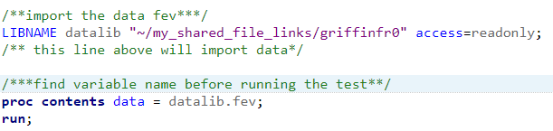
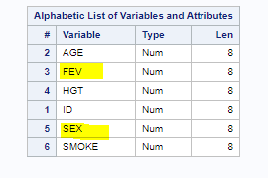
Comparing the Means of Two Independent Groups
Preformed a two sample t-test using SAS example
Pulmonary Disease continued
Code: Results

Slide 14
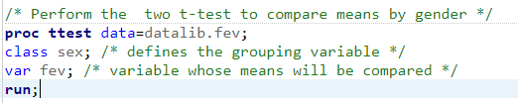
Comparing the Means of Two Independent Groups
Preformed a two sample t-test using SAS example
Pulmonary Disease continued
Code: Results

Slide 15
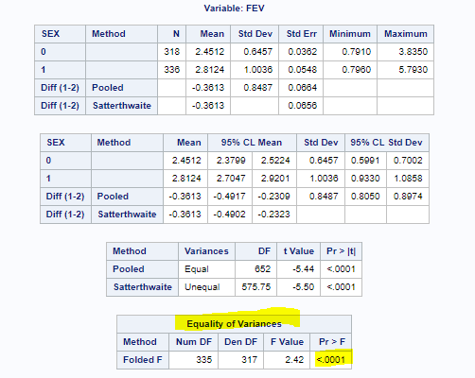
Comparing the Means of Two Independent Groups
Preformed a two sample t-test using SAS example
Pulmonary Disease continued
Look at the Equality of Variance test first to determine if it variances are
equal or unequal
The test assumes equal variance under the null
If the p-value is less than 0.05, then the variances are unequal
If the p-value is greater than 0.05 , then the variances are equal
Use the t-test statistics and p-value from that line
The p-value is less than 0.05, use unequal variance (Satterwaite method)

Slide 16
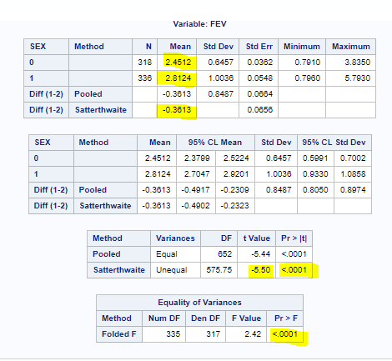
Comparing the Means of Two Independent Groups
Preformed a two sample t-test using SAS example
Pulmonary Disease continued
What is the mean of female?
2.4512
What is the mean of males?
2.8124
What is the difference in means?
-0.3613
What is the t-test statistics?
t= -5.50
What is the p-value?
<.0001
What is the conclusion?
.0001<0.05 reject (because p-value < α ⇒ Reject H₀₎
We reject the null hypothesis, there is evidence that there is a difference in mean FEV between males and females

